Slide 1
RUNGTA COLLEGE OF DENTAL SCIENCES & RESEARCH
DRUG RESISTANCE IN BACTERIA
DEPARTMENT OF MICROBIOLOGY

Slide 2
Specific learning Objectives
At the end of this presentation the learner is expected to know ;
Core areas* | Domain ** | Category #
Introduction | Cognitive | Nice to know
Mechanism | Cognitive | Must know
Factors | Affective | Nice to know
Mutation | Psychomotor | Desired to know

Slide 3
Table of Content
Introduction
Mechanism
Factors affecting Drug Resistance
Mutation

Slide 4
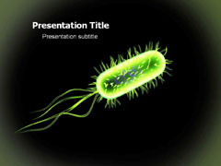
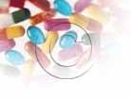
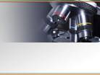
MICROBIOLOGY
DRUG RESISTANCE IN BACTERIA

Slide 5
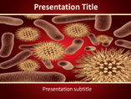
INDEX
RESISTANCE
NATURAL RASISTANCE
ACQUIRED RESISTANCE
*MECHANISM
*FACTORS EFFECTING
-CROSS RESISTANCE
-SUPER INFECTION
-LIMITATIONS OF DRUG RESISTANCE

Slide 6
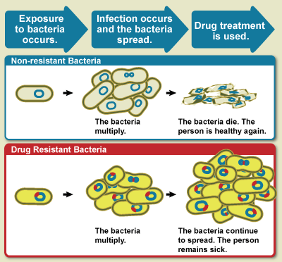
Resistance is defined as the unresponsiveness of a microorganism to antimicrobial agents(AMA).
Resistance

Slide 7
The resistance may be of two types:- [1]Natural resistance [2]Acquired resistance
[1] NATURAL RESISTANCE/NON GENETIC ORIGIN OF DRUG RESISTANCE/INTRINSIC RESISTANCE.
Organisms that are naturally insensitive to a particular drug. Active replication of bacteria is required for most antibacterial drug action.
The bacteria that are metabolically inactive(non multiplying) may be phenotypically resistance to drug. However their offspring are fully suseceptible.

Slide 8
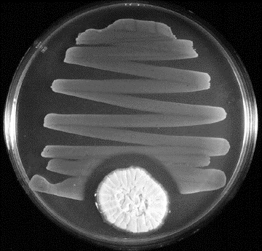
Ex:- Mycobacteria often survive in tissue for many years after infection yet are restrained by the host’s defenses and don’t multiply. Such “persisting” organism are resistant to treatment and cannot be eradicated by drugs. Yet if they start to multiply (ex:following suppression of cellular immunity in the patient) they are fully susceptible to the same drug. Secondly if microorganism may lose the specific target structure for several generations and thus be resistant.
Penicillin inhibition of bacterial growth

Slide 9
Ex:- PENICILLIN act on Penicillin-susceptible organism Cell wall deficient L-form Lacking of cell wall (They are resistant to cell wall inhibitor drug eg:- penicillin,cephalosporin) When these organisms revert to their bacterial parent forms by resuming cell wall production, they are again susceptible to penicillin.

Slide 10
Thirdly microorganism may infect the host at the site where antimicrobials are excluded or are not active. Ex:- Aminoglycosides such as gentamicin are not effective in treating salmonella enteric fevers because the salmonella are intracellular and the aminoglycosides don’t enter the cell. [2] ACQUIRED RESISTANCE/GENETIC ORIGIN OF DRUG RESISTANCE. In acquired resistance the microbes that initially respond to an AMA later develop resistance the to same AMA by:- (a)Mutation (b)Gene transfer

Slide 11
MECHANISM:- Mechanism of development of resistance to AMAs:- <a> Production of inactivating enzyme. Ex:- Staphylococci produces β- lactamases (penicillinase) which destroys some of penicillins & cephalosporins

Slide 12
<b> An efflux pump mechanisms:- Microorganism change their permiability to drug. Mechanism that prevents accumulation of drug in bacteria. Ex:- Resistance of gram +ve & gram –ve bacteria to tetracyclines. <c> Alteration of binding site:- Ex:- Change in penicillin-binding proteins(PBPs) resulting in decreased affinity for penicillins. <d> Absence of metabollic pathway:- Sulphonamide resistant bacteria can utilize

Slide 13
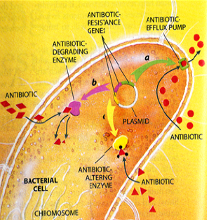
performed folic acid without need for usual metabolic steps. PABA sulphonamide inhibits folate synthatase folic acid producing bacteriostatic effect.

Slide 14
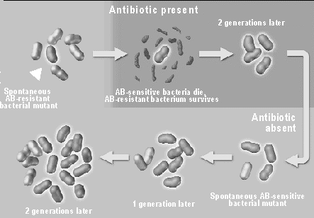
A problem of chemotherapy has been the appearance of resistance to particular drugs in a normally sensitive microbial population.

Slide 15
FACTORS AFFECTING:-
Three main factors affect the frequency of acquired resistance:-
1.Amount of antibiotic used. 2.Frequency with which bacteria undergoes spontaneous mutation to resistance. 3.Prevalence of plasmids able to transfer resistance from one bacterium to another.

Slide 16
MUTATIONAL DRUG RESISTANCE (CHROMOSOMAL) | TRANSFERABLE DRUG RESISTANCE (EXTRACHROMOSOMAL )
1.Mutational resistance. 2.Resistance to one drug at a time. 3.Low degree resistance.,therefore can be treated by high doses of antibiotics. 4.Resistance can be treated by combination of drugs. 5.Resistance mutants may be defective. 6.Virulence of resistance mutants may be lowered. | 1.Transferable resistance. 2.Multiple drug resistance. 3.High degree resistance.,higher doses of antibiotics do not help. 4.Cannot be prevented by treatment with combination of drugs. 5.Not defective. 6.Virulence not decreased.

Slide 17
Mutational resistance develops as a result of spontaneous mutation in a locus that controls susceptibility to a given antimicrobial drug. The presence of the antimicrobial drug serves as a selecting mechanism to supress susceptible organism & favour the growth of drug resistant mutants. Mutation resistant is mainly of 2 types:- (a).THE STEPWISE MUTATION. (b).THE ONE STEP MUTATION.
[A] MUTATIONAL DRUG RESISTANCE.

Slide 18
(a).THE STEPWISE MUTATION. It is seen with penicillin, where high level of resistance are achieved only by a series of small step mutations. (b).ONE STEP MUTATION. It is seen with streptomycin,where mutants differ widely in the degree of resistance:- 1.some exhibiting low resistance. 2.some are highly resistant. 3.some even streptomycin dependent.

Slide 19
In clinical practise,mutational resistance is of greater importance in tuberculosis. If only one drug is used i.e., streptomycin patient initially the bacilli die in large number soon resistant mutants appears & multiply.

Slide 20
If two or more antituberculous drugs are used for combined treatment,repopulation by resistant mutants doesn’t occur,as a mutant resistant to one drug will be destroyed by other drug. The possibility of a mutant does not occur,as a exhibiting resistance to multiple drugs.Simultaneously is so remote as to be visually not existent. But due to inadequate treatment from long time to this disease causes extensive resistance in tubercle bacilli, leading to pandaemic of multiple drug resistant tuberculosis (MDR TB) across the world.

Slide 21
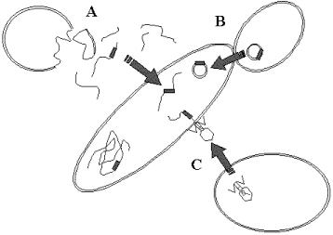
In transferable drug resistance the resistance is transferred from one bacteria to different taxonomic groups by different methods of “gene transfer”,mediated by “R-plasmids”(RTF+r determinants). The transfer of genes for drug resistance occur by following mechanisms:-
[B] TRANSFERABLE DRUG RESISTANCE/PLASMID-MEDIATED DRUG RESISATNCE.
A=TRANSFORMATION.
B=CONJUGATION.
C=TRANSDUCTION.

Slide 22
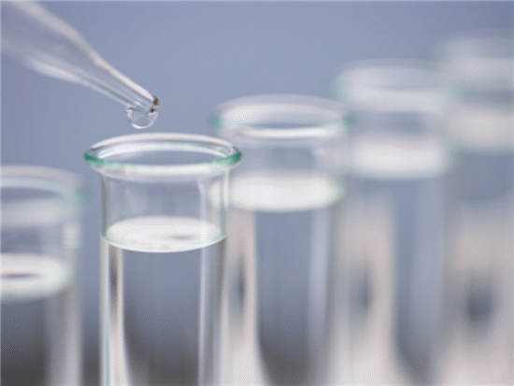
Of three modes of gene transfer in bacteria plasmid-mediated conjugation is of greatest significance in terms of drug resistance. Conjugation occurs through R plasmids(RTF+r determinant). R-Plasmid : Plasmid is responsible for the spread of multiple drug resistance among bacteria. This mechanism of drug resistance was 1st reported by japanese workers. It showed sudden increase in infection caused by shigella strain-resistant to sulphonamides, streptomycin.

Slide 23
These patients excreting shigella strain also shed strains of E.coli resistant to same drug. So, transfer was demonstrated between E.coli & shigella strains both in vitro & in vivo. The R-plasmid consist of:- (a) RESISTANCE TRANSFER FACTOR (RTF) (b) RESISTANCE DETERMINANT(r) The whole plasmid is called as R factor(RTF+r) R factor can have several r determinants & resistance to as many as eight or more drugs can be transferred.

Slide 24
Sometimes,RTF dissociates from r-determinants. 2 components exists as separate plasmids host cell remains drug resistant & resistance is not transferable. R-plasmids transfer themselves into a wide range of commensal & pathogenic bacteria. The transfer can be effected in vitro,but in normal gut inhibited by several factors such as bile salts, alkaline pH,abundance of anaerobic gram positive bacteria minimizing chances of contact b/w donor cells & suitable recipient cells.

Slide 25
In intestine of persons with oral antibiotic therapy,transfer occurs due to destruction of sensitive normal flora & selection pressure produced by drug. Transferable drug resistance is now universal in distribution & involves all antibiotics in common use. Frequency α use of antibiotics in the area. R-factors can be transmitted from animals to mans. Hence,antibiotics in veterinary & animal feeds can also lead to increase of mutiple drug resistance in community. Widespread resistance has considerably diminished clinical efficacy of most of antibiotics.

Slide 26
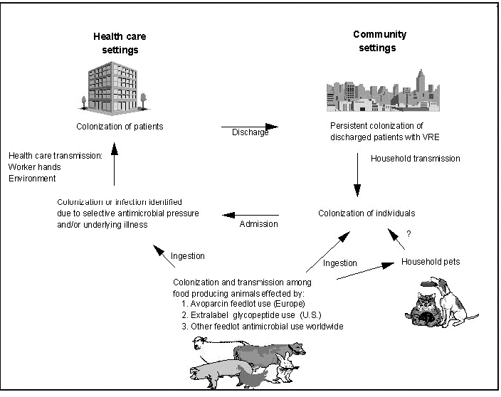

Slide 27
Transposable genetic elements.(transposons). They are specific sequences of DNA segments. .have ability to move from one plasmid to another plasmid. .plasmid ↔ chromosome. .also within chromosome. Because of their ability to insert into many sites both on plasmids & chromosomes, they are known as “JUMPING GENES’. The transfer of genetic material from 1 DNA to another is c/as transposition. Small transposons are k/as “INSERTION SEQUENCES" or IS elements. Bacteria acquires new characters by insertion of transposable element.

Slide 28
Integron. These elements form an essential ‘building block’ of many transposons. They allow rapid formation & expression of new combinations of antibiotic resistance genes in response to selection pressure. The prevalence of multiple resistance R-plasmids carrying transposons & integron continues to increase infections caused by a wide range of pathogens. Use of antibiotics may select for bacteria carrying plasmids that confer not only multiple drug resistance but also increase pathogenicity.

Slide 29
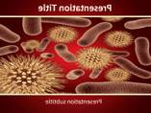
Organisms that develop resistance to an AMA may also show resistance to other chemically related AMAs. The cross resistance among AMA could either be:- 1-way. 2-way. Among tetracyclines & sulphonamides is usually 2-way. The 1-way resistance is seen b/w gentamicin & streptomycin. TETRACYCLINES DOXYCYCLINE SULPHADIAZINE SULPHADOXINE GENTAMICIN STREPTOMYCIN
Cross resistance.

Slide 30
Super infection is defined as the appearance of a new infection due to antimicrobial therapy of initial infection. The causative organism of super infection should be different from that of primary diseases. The antibiotics having broad spectrum (tetracyclines,chloramphenicol,etc.) alter normal bacterial flora. Host defense mechanisms are impaired. Pathogenic organisms invade the host multiply & produce the super infection.
Super infection(supra infection)

Slide 31
The sites involved in super infection are those body cavities that have direct communication with the exterior. i.e., 1.Rectum. 2.Oral cavity. 3.Vagina. 4.Lower urinary tract. 5.Upper respiratory tract.,etc.

Slide 32
(1).By maintaining sufficiently high levels of drug in the tissues to inhibit both the original population & 1st step mutants. (2).By administrating 2 drugs that do not give cross-resistance each of which delay the emergence of mutants resistant to other drug. Ex:-rifamipin & isoniazid used in treatment of tuberculosis. (3).By avoiding exposure of micro-organisms to a particularly valuable drug by limiting its use, especially in hospitals it is said that “hospital is the heaven for drug resistant bacteria”.
LIMITATIONS OF DRUG RESISTANCE:-

Slide 33
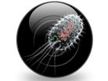

Slide 34
TAKE HOME MESSAGE/ FOR THE TOPIC COVERED (SUMMARY)
Brief knowledge about classes of Antibiotics
Mechanism of Drug Resistance in Bacteria

Slide 35
REFERENCES
Microbiology – Prescott, et al.
Microbiology – Bernard D. Davis, et al.
Clinical & Pathogenic Microbiology – Barbara J Howard, et al.
Immunology an Introduction – Tizard.
Immunology 3rd edition – Evan Roitt, et al.
Medical Microbiology – Greenwood
Textbook of Microbiology – Ananthnarayan
The short Text Book of Microbiology – Satish Gupte

Slide 36
Question & Answer Session
Students should be given opportunity to ask question for clarifying for their understand/ confusions. Teachers must spend 5-10 minutes for this to improve the output.

Slide 37
THANK YOU

